Slide 1



School Information Report
Please click the ‘speaker icon’ on each page to hear each question answered through a recording from our School SENCO.
Made in conjunction with our SEN governor and a variety of parents

Slide 2


Slide 3


Slide 4
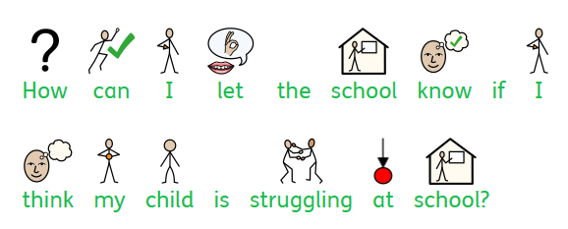

Slide 5
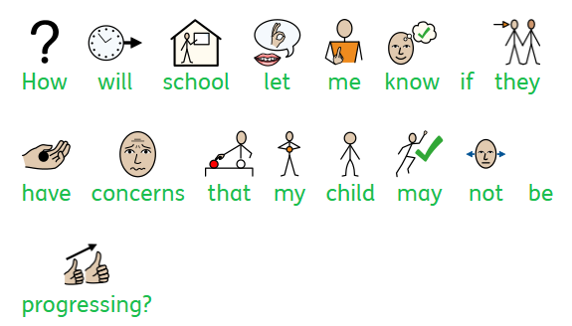

Slide 6
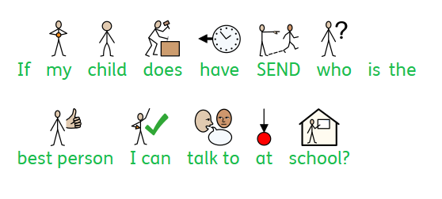

Slide 7


Slide 8
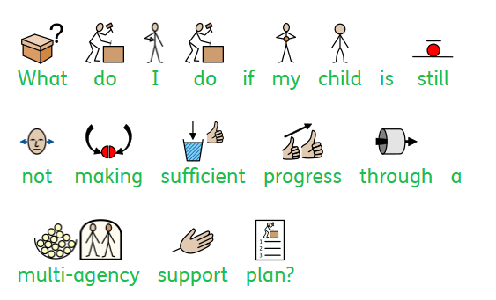

Slide 9


Slide 10
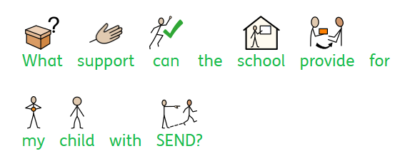

Slide 11
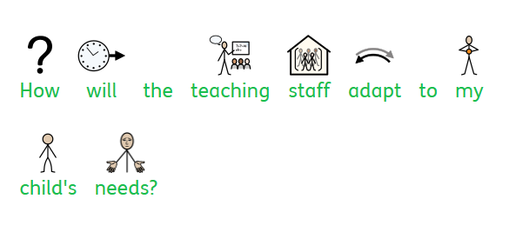

Slide 12
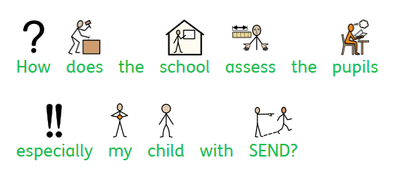

Slide 13

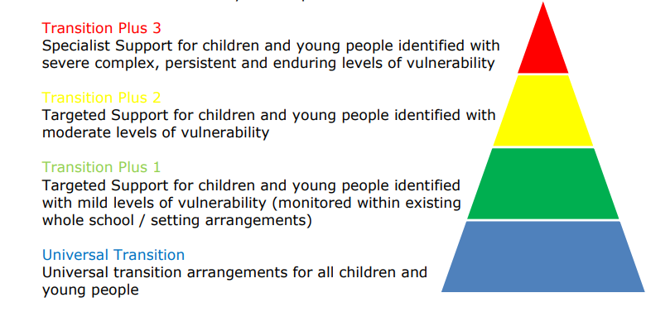

Slide 14
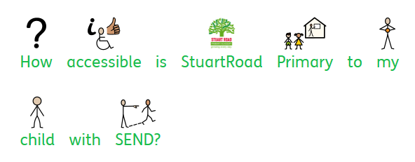

Slide 15
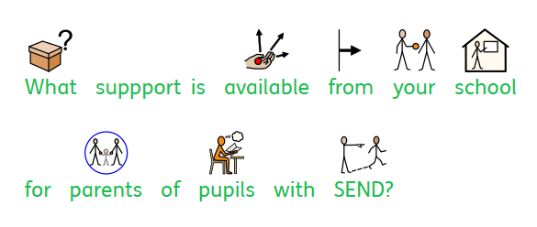

Slide 16


